Slide 1

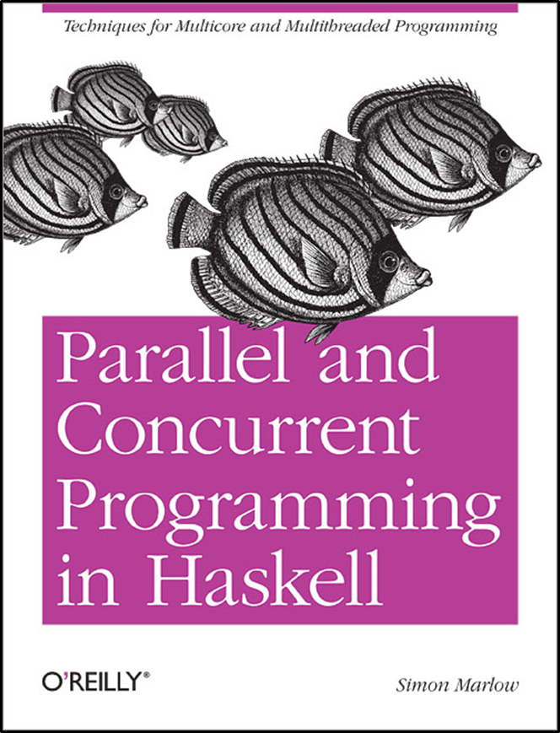

IMPLEMENTAREA CONCURENTEI IN LIMBAJE DE PROGRAMARE
Concurenta
Threaduri
Memorie Partajata
Ioana Leustean
Part II. Concurrent Haskell
Cap.7 & 8
https://hackage.haskell.org/package/base-4.20.0.1/docs/Control-Concurrent.html

Slide 2


data MVar a
newEmptyMVar :: IO (MVar a) -- m <- newEmptyMVar
-- m este o locatie goala
newMVar :: a -> IO (MVar a) -- m <- newMVar v
-- m este o locatie care contine valoarea v
putMVar :: Mvar a -> a -> IO() -- putMVar m v
-- pune in m valoarea v
-- asteapta (blocheaza thread-ul) daca m este plina
takeMVar :: MVar a -> IO a -- v <- takeMVar m
-- intoarce in v valoarea din m si goleste m
-- asteapta (blocheaza thread-ul) daca m este goala
readMVar :: MVar a -> IO a -- v <- readMVar m citeste atomic continutul lui m
-- intoarce in v valoarea din m dar aceasta ramane in m
-- asteapta (blocheaza thread-ul) daca m este goala
m

Slide 3
“Concurrent computing is a form of computing in which several computations are executing during overlapping
time periods—concurrently—instead of sequentially (one completing before the next starts)[…]
A concurrent system is one where a computation can advance without waiting for all other computations to complete;
where more than one computation can advance at the same time.”
Operating System Concepts 9th edition, Abraham Silberschatz
import Data.ByteString as B
import GetURL
main = do
m1 <- newEmptyMVar
forkIO $ do
r <- getURL "http://..."
putMVar m1 r
m2 <- newEmptyMVar
forkIO $ do
r <- getURL "http://..."
putMVar m2 r
r1 <- takeMVar m1
r2 <- takeMVar m2
print (B.length r1, B.length r2)
Exemplu: incarcarea mai multor pagini web
secvential
concurent
Thread 1
Thread 2
geturl1.hs ©2012, Simon Marlow

Slide 4
Comunicare asincrona
Se creaza un thread separat pentru fiecare actiune si se asteapta rezultatul
data Async a = Async (MVar a)
async :: IO a -> IO (Async a)
async action = do
var <- newEmptyMVar
forkIO (do r <- action; putMVar var r)
return (Async var)
wait :: Async a -> IO a
wait (Async var) = readMVar var
var <- newEmptyMVar
forkIO $ do
r <- getURL "http://... "
putMVar var r
takeMVar var
a <- async (getURL "http://... " )
wait a
readMVar nu devine goala dupa citire (multiple-wakeup)
deci mai multe apeluri wait pot fi facute pentru
aceeasi operatie asincrona

Slide 5
Comunicare asincrona
Se creaza un thread separat pentru fiecare actiune si se asteapta rezultatul
data Async a = Async (MVar a)
async :: IO a -> IO (Async a)
async action = do
var <- newEmptyMVar
forkIO (do r <- action; putMVar var r)
return (Async var)
wait :: Async a -> IO a
wait (Async var) = readMVar var
import Data.ByteString as B
import GetURL
main = do
a1 <- async (getURL "http://..." )
a2 <- async (getURL "http://..." )
r1 <- wait a1
r2 <- wait a2
print (B.length r1, B.length r2)
a <- async action
r <- wait a

Slide 6
Comunicare asincrona
import Data.ByteString as B
import GetURL
import TimeIt
import Text.Printf
timeDownload :: String -> IO ()
timeDownload url = do
(page, time) <- timeit $ getURL url
printf " %s (%d bytes, %.2fs)\n" url (B.length page) time
main = do
a1 <- async (timeDownload "http://..." )
a2 <- async (timeDownload "http://..." )
wait a1
wait a2
data Async a = Async (MVar a)
async :: IO a -> IO (Async a)
async action = do
var <- newEmptyMVar
forkIO (do r <- action; putMVar var r)
return (Async var)
wait :: Async a -> IO a
wait (Async var) = readMVar var
a <- async action
r <- wait a

Slide 7
Comunicare asincrona
import Data.ByteString as B
import GetURL
import TimeIt
import Text.Printf
timeDownload :: String -> IO ()
timeDownload url = do
(page, time) <- timeit $ getURL url
printf "downloaded: %s (%d bytes, %.2fs)\n" url (B.length page) time
main = do
a1 <- async (timeDownload "http://..." )
a2 <- async (timeDownload "http://..." )
wait a1
wait a2
vor fi afisate statistici privind timpul de executie

Slide 8
Comunicare asincrona
import Control.Concurrent
import Text.Printf
import qualified Data.ByteString as B
import GetURL -- parconc-examples
import TimeIt -- parconc-examples
timeDownload :: String -> IO ()
timeDownload url = do
(page, time) <- timeit $ getURL url
printf " %s (%d bytes, %.2fs)\n" url (B.length page) time
data Async a = Async (MVar a)
async :: IO a -> IO (Async a)
async action = do
var <- newEmptyMVar
forkIO (do r <- action; putMVar var r)
return (Async var)
wait :: Async a -> IO a
wait (Async var) = readMVar var
sites =["url1","url2",…]
main = do
as <- mapM (async . timeDownload) sites
mapM_ wait as
geturl3.hs ©2012, Simon Marlow

Slide 9
geturl3.hs ©2012, Simon Marlow
Async - comunicare asincrona (folosind MVar)
import Control.Concurrent
import Text.Printf
import qualified Data.ByteString as B
import GetURL -- parconc-examples
import TimeIt -- parconc-examples
timeDownload :: String -> IO ()
timeDownload url = do
(page, time) <- timeit $ getURL url
printf " %s (%d bytes, %.2fs)\n" url (B.length page) time
data Async a = Async (MVar a)
async :: IO a -> IO (Async a)
async action = do
var <- newEmptyMVar
forkIO (do r <- action; putMVar var r)
return (Async var)
wait :: Async a -> IO a
wait (Async var) = readMVar var
main = do
as <- mapM (async . timeDownload) sites -- sites =["url1","url2",…]
mapM_ wait as
asteapta ca toate actiunile asincrone sa se termine,
monitorizand fiecare actiune in parte; un alt thread ar putea
interveni inainte ca toate actiunile sa se termine
Cum rezolvam aceasta problema?

Slide 10
Exemplu: o tranzactie bancara(I)
type Account = MVar Int
deposit :: Account -> Int -> IO() -- depunere
deposit acc amount = do
x <- takeMVar acc
putMVar acc (x + amount)
withdraw :: Account -> Int -> IO() -- retragere
withdraw acc amount = do
x <- takeMVar acc
putMVar acc (x - amount)
showBalance :: Account -> String -> IO() -- sold
showBalance acc str = do
x <- takeMVar acc
putMVar acc x
putStrLn ("Contul " ++ str ++ ": " ++ (show x))

Slide 11
Exemplu: o tranzactie bancara (I)
import Control.Concurrent
import Control.Monad
type Account = MVar Int)
main = do
aMVar <- newMVar 1000
bMVar <- newMVar 1000
forkIO(transfer aMVar bMVar 300)
forkIO (transfer bMVar aMVar 500)
showBalance aMVar "a"
showBalance bMVar "b"
transfer :: Account -> Account -> Int -> IO()
transfer from to amount = do
withdraw from amount
deposit to amount
data race
un alt thread ar putea observa o stare
in care banii nu se gasesc in nici un cont

Slide 12
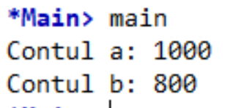
Exemplu: o tranzactie bancara (I)
transfer :: Account -> Account -> Int -> IO()
transfer from to amount = do
withdraw from amount
-- threadDelay (5^6)
deposit to amount
transfer :: Account -> Account -> Int -> IO()
transfer from to amount = do
withdraw from amount
-- threadDelay (5^6)
deposit to amount
compunerea unor
operatii corecte
poate avea ca rezultat o
operatie eronata
main = do
aMVar <- newMVar 1000
bMVar <- newMVar 1000
forkIO(transfer aMVar bMVar 300)
forkIO (transfer bMVar aMVar 500)
showBalance aMVar "a"
showBalance bMVar "b"

Slide 13
Ideea: tranzactiile in baze de date
A transaction is a sequence of operations performed as a single logical unit of work. A logical unit of work must exhibit four properties, called the atomicity, consistency, isolation, and durability (ACID) properties, to qualify as a transaction.
Atomicity - A transaction must be an atomic unit of work; either all of its data modifications are performed, or none of them is performed.
Consistency - When completed, a transaction must leave all data in a consistent state.
Isolation - Modifications made by concurrent transactions must be isolated from the modifications made by any other concurrent transactions.
Durability - After a transaction has completed, its effects are permanently in place in the system. The modifications persist even in the event of a system failure.
https://technet.microsoft.com/en-us/library/ms190612%28v=sql.105%29.aspx

Slide 14
Atomicitate
Modalități de sincronizare de nivel scăzut: variabile atomice
Atomicitate fără sincronizare. mult mai rapide decât cu locks
Java: AtomicInteger, AtomicBoolean, …
get(), set(), incrementAndGet(), addAndGet(int d), compareAndSet(int old, int new)
Haskell: IORef a
newIORef, readIORef, writeIORef, atomicModifyIORef, atomicWriteIORef
Metodele sunt implementate folosind instrucțiuni hardware compare-and-swap
Modalitati de sincronizare de nivel inalt: Software Transactional Memory (STM)
sincronizare fara lacate
blocuri de instructiuni executate atomic

Slide 15
Haskell: variabile atomice
doua thread-uri care incrementeaza acelasi contor
data IORef a
newIORef :: a -> IO (IORef a)
readIORef :: IORef a -> IO a
import Control.Concurrent
import Control.Monad
import Data.IORef (newIORef, readIORef, atomicModifyIORef')
data Async a = Async (MVar a)
async :: IO a -> IO (Async a)
wait :: Async a -> IO a
add m = replicateM_ 1000 $ atomicModifyIORef' m (\x -> (x+1,()))
main = do
m <- newIORef 0
a1<-async (add m )
a2<-async (add m )
r1 <- wait a1
r2 <- wait a2
x <- readIORef m
print x
atomicModifyIORef' :: IORef a -> (a -> (a, b)) -> IO b

Slide 16
Haskell: variabile atomice
doua thread-uri care incrementeaza acelasi contor
data IORef a
newIORef :: a -> IO (IORef a)
readIORef :: IORef a -> IO a
atomicModifyIORef' :: IORef a -> (a -> (a, b)) -> IO b
main = do
st <- newIORef ""
a1 <-async $ replicateM 5 $ atomicModifyIORef' st (\s -> s ++ "A")
a2 <- async $ replicateM 5 $ atomicModifyIORef' st (\s -> s ++ "B")
a3 <- async $ replicateM 5$ atomicModifyIORef' st (\s -> s ++ "C")
r1 <- wait a1
r2 <- wait a2
r3 <- wait a3
x <- readIORef st
print x

Slide 17
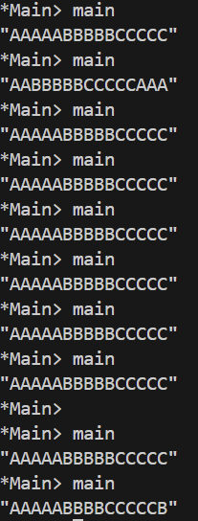
Haskell: MVar
trei thread-uri care incrementeaza acelasi contor
import System.Random
act m x = do
-- t <- getStdRandom (randomR (100, 1000))
-- threadDelay t
s <- takeMVar m
putMVar m (s ++ x)
main = do
st <- newMVar ""
a1 <-async $ replicateM 5 $ act st "A"
a2 <- async $ replicateM 5 $ act st "B"
a3 <- async $ replicateM 5 $ act st "C"
r1 <- wait a1
r2 <- wait a2
r3 <- wait a3
x <- readMVar st
print x

Slide 18
STM: Tranzactii bancare
transfer :: Account -> Account -> Int -> IO()
transfer from to amount = atomically $ do
withdraw from amount
deposit to amount
atomically
"takes an action as its argument, and performs it atomically.
More precisely, it makes two guarantees:
Atomicity: the effects of atomically act become
visible to another thread all at once.
This ensures that no other thread can see
a state in which money has been deposited
in to but not yet withdrawn from from.
Isolation: during a call atomically act,
the action act is completely unaffected
by other threads. It is as if act takes
a snapshot of the state of the world
when it begins running, and then executes
against that snapshot."
Simon Peyton Jones, Beautiful Concurrency

Slide 19
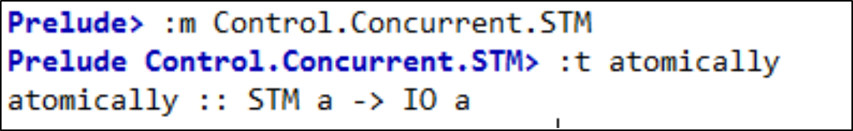
Monada STM
este asemanatoare monadei IO
TVar
variabile tranzactionale
type Account = TVar Int
deposit :: Account -> Int -> STM ()
deposit acc amount = do
x <- readTVar acc
writeTVar acc (x + amount)
withdraw :: Account -> Int -> STM ()
withdraw acc amount = do
x <- readTVar acc
writeTVar acc (x - amount)
deposit
actiune STM
withdraw
actiune STM
transfer :: Account -> Account -> Int -> IO()
transfer from to amount = atomically $ do
withdraw from amount
deposit to amount
atomically :: STM a -> IO a
executa atomic o actiune STM

Slide 20
Monada STM
Operatiile de baza ale monadei STM sunt
scrierea si citirea variabilelor tranzactionale.
Variabilele tranzactionale sunt mutabile.
O variabila TVar nu poate fi goala.
Scrierea si citirea variabilelor tranzactionale
se face fara blocare.
Actiunile STM au loc atomic.
O tranzactie este o actiune STM care este
executata in monada IO folosind atomically
data STM a
instance Monad STM
atomically :: STM a -> IO a
data TVar a
newTVar :: a -> STM (TVar a)
readTVar :: TVar a -> STM a
writeTVar :: TVar a -> a -> STM ()

Slide 21
Implementarea STM
"One particularly attractive implementation is well established in the database world, namely optimistic execution. When (atomically act) is performed, a thread-local transaction log is allocated, initially empty. Then the action act is performed, without taking any locks at all. While performing act, each call to writeTVar writes the address of the TVar and its new value into the log; it does not write to the TVar itself. Each call to readTVar first searches the log (in case the TVar was written by an earlier call to writeTVar); if no such record is found, the value is read from the TVar itself, and the TVar and value read are recorded in the log. In the meantime, other threads might be running their own atomic blocks, reading and writing TVars like crazy.
When the action act is finished, the implementation first validates the log and, if validation is successful, commits the log. The validation step examines each readTVar recorded in the log, and checks that the value in the log matches the value currently in the real TVar. If so, validation succeeds, and the commit step takes all the writes recorded in the log and writes them into the real TVars.
What if validation fails? Then the transaction has had an inconsistent view of memory. So we abort the transaction, re-initialise the log, and run act all over again"
Simon Peyton Jones, Beautiful Concurrency

Slide 22
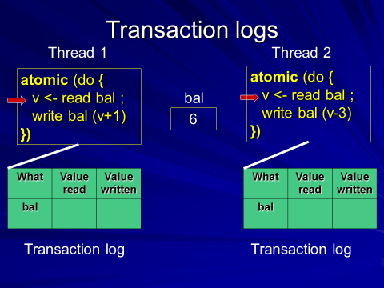
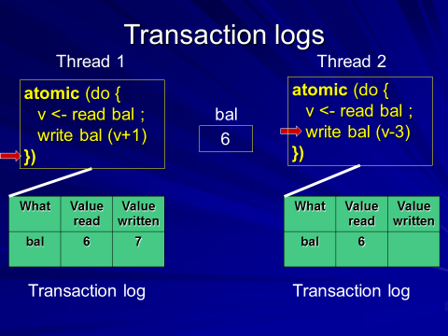
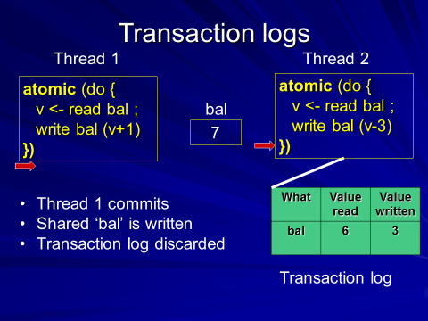
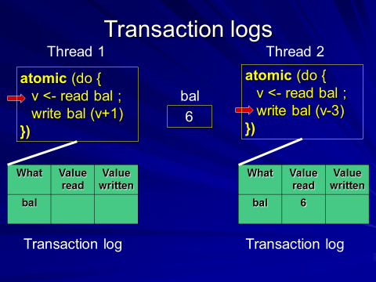

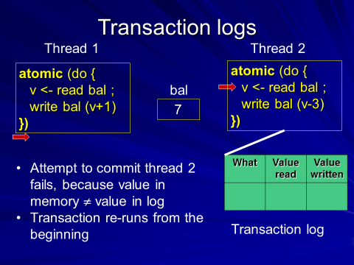
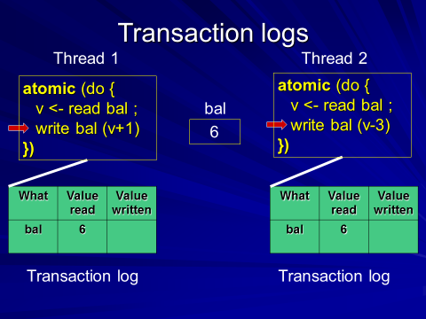
1
6
4
2
7
5
3
T. Harris, M. Herlihy, S. Marlow, S. Peyton Jones,
Concurrency unlocked
click pe prezentare

Slide 23
Variabile mutabile: IORef, MVar, TVar
import Data.IORef
-- variabile mutabile in monada IO
newIORef :: a -> IO (IORef a)
readIORef :: IORef a -> IO a
writeIORef :: IORef a -> a -> IO ()
import Control.Concurrent.STM.TVar
-- variabile tranzactionale
-- variabile mutabile in monada STM
newTVar :: a -> STM (TVar a)
readTVar :: TVar a -> STM a
writeTVar :: TVar a -> a -> STM ()
add :: IORef Int -> Int -> IO()
add rref n = do
val <- readIORef rref
writeIORef rref
main = do
rref <- newIORef 0
add rref 10
val <- readIORef rref
print val
import Control.Concurrent.MVar
-- variabile de sincronizare
-- variabile mutabile in monada IO
newEmptyMVar :: IO (MVar a)
newMVar :: a -> IO (MVar a)
takeMVar :: MVar a -> IO a -- blocheaza thread-ul
putMVar :: MVar a -> a -> IO () -- blocheaza thread-ul

Slide 24
import Control.Concurrent
import Control.Monad
import Control.Concurrent.STM
type Account = TVar Int
deposit :: Account -> Int -> STM ()
deposit acc amount = do
x <- readTVar acc
writeTVar acc (x + amount)
withdraw :: Account -> Int -> STM ()
withdraw acc amount = do
x <- readTVar acc
writeTVar acc (x - amount)
showBalance :: Account -> String -> IO()
showBalance acc str = do
x <- atomically $ readTVar acc
putStrLn ("Contul " ++ str ++ ": " ++ (show x))
mybankstm.hs
transfer :: Account -> Account -> Int -> IO()
transfer from to amount = atomically $ do
withdraw from amount
deposit to amount
main = do
(a,b) <- atomically $ do
a <- newTVar 1000
b <- newTVar 1000
return (a,b)
forkIO(transfer a b 300)
forkIO (transfer b a 500)
showBalance a "a"
showBalance b "b"
compozitionalitate

Slide 25
Blocare (blocking)
"Suppose that a thread should block if it attempts to overdraw an account (i.e. withdraw more than the current balance). Situations like this are common in concurrent programs: for example, a thread should block
if it reads from an empty buffer, or when it waits for an event. We achieve this in STM by adding the single function retry, whose type is
The semantics of retry are simple: if a retry action is performed, the current transaction is abandoned and retried at some later time."
retry :: STM a
check :: Bool -> STM ()
check True = return ()
check False = retry
limitedWithdraw :: Account -> Int -> STM ()
limitedWithdraw acc amount = do
bal <- readTVar acc
if amount > 0 && amount > bal
then retry
else writeTVar acc (bal - amount)
.
limitedWithdraw :: Account -> Int -> STM ()
limitedWithdraw acc amount = do
bal <- readTVar acc
check (amount <= 0 || amount <= bal)
writeTVar acc (bal - amount)
sau
Simon Peyton Jones, Beautiful Concurrency
Notes:
Implementarea retry: threadul este blocat pana cand se face o scriere intr-o varaiabila TVar pe care threadul o citeste; atunci theradul este deblocat si se reia executia

Slide 26
Alegerea (choice)
"Suppose you want to withdraw money from account A if it has enough money, but if not then withdraw it
from account B? For that, we need the ability to choose an alternative action if the first one retries.
To support choice, STM Haskell has one further primitive action, called orElse, whose type is
Its semantics are as follows: the action (orElse a1 a2) first performs a1;
if a1 retries (i.e. calls retry), it tries a2 instead;
if a2 also retries, the whole action retries. "
limitedWithdraw :: Account -> Int -> STM ()
limitedWithdraw acc amount = do
bal <- readTVar acc
if amount > 0 && amount > bal
then retry
else writeTVar acc (bal - amount)
limitedWithdraw2 :: Account -> Account -> Int -> STM ()
limitedWithdraw2 acc1 acc2 amt
= orElse (limitedWithdraw acc1 amt) (limitedWithdraw acc2 amt)
.
Exercitiu: Modificati mybankstm.hs adaugand retry si orElse
Simon Peyton Jones, Beautiful Concurrency

Slide 27
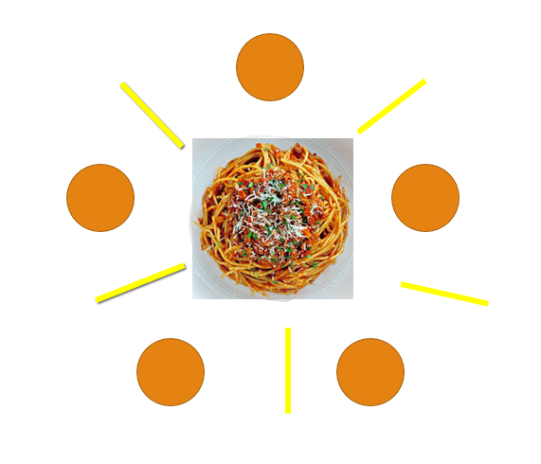
The Dining Philosophers
http://rosettacode.org/wiki/Dining_philosophers
http://www.tobiasmuehlbauer.com/2011/07/24/stm-haskell-dining-philosophers-problem/
http://www-ps.informatik.uni-kiel.de/~fhu/projects/stm.pdf

Slide 28
"In ancient times, a wealthy philanthropist endowed a College to accommodate
five eminent philosophers. Each philosopher had a room in which he could engage in his professional activity of thinking; there was also a common dining
room, furnished with a circular table, surrounded by five chairs, each labelled
by the name of the philosopher who was to sit in it. The names of the philosophers were PHIL0, PHIL1, PHIL2, PHIL3, PHIL4, and they were disposed in this
order anticlockwise around the table. To the left of each philosopher there was
laid a golden fork, and in the center stood a large bowl of spaghetti, which was
constantly replenished.
A philosopher was expected to spend most of his time thinking; but when
he felt hungry, he went to the dining room, sat down in his own chair, picked
up his own fork on his left, and plunged it into the spaghetti. But such is the
tangled nature of spaghetti that a second fork is required to carry it to the
mouth. The philosopher therefore had also to pick up the fork on his right.
When we was finished he would put down both his forks, get up from his chair,
and continue thinking. Of course, a fork can be used by only one philosopher
at a time. If the other philosopher wants it, he just has to wait until the fork
is available again."
C.A.R. Hoare, Communicating Sequential Processes, 2004
(formulate initial de E. Dijkstra

Slide 29
Dining Philosophers
Fiecare filozof executa
la infinit urmatorul ciclu
n = numarul de filozofi
asteapta sa manance
ia furculita stanga
Ia furculita dreapta
mananca
elibereaza furculita stanga
elibereaza furculita dreapta
mediteaza
i(mod n)
Phil i
i+1 (mod n)

Slide 30
Probleme
Excludere mutuala - doi filozofi diferiti nu pot folosi aceeasi furculita simultan
Coada circulara – filozofii se asteapta unul pe celalat
Deadlock
Fiecare filozof are o furculita si asteapta
ca ceilalti vecini sa elibereze o furculita
Starvation
Un filozof nu mananca niciodata
(ex: unul din vecini nu elibereaza furculita)

Slide 31
Fiecare filozof executa la infinit urmatorul ciclu
-- asteapta sa manance
mananca
mediteaza
ia furculita stanga
Ia furculita dreapta
actiuni atomice - elimina
deadlock
elibereaza furculita stanga
elibereaza furculita dreapta
durata finita – elimina
starvation

Slide 32
Dining Philosophers – varianta 1
dinnersrc1.hs
Fork
b :: Bool
s :: TVar
type Fork = TVar Bool
takeFork :: Fork -> STM ()
takeFork s = do
b <- readTVar s
if b then writeTVar s False
else retry -- asteapta pana se elibereaza furculita
releaseFork :: Fork -> STM ()
releaseFork fork = writeTVar fork True
-- True daca furculita este libera

Slide 33
import System.Random
type Name = String
runPhilosopher :: (Name, (Fork, Fork)) -> IO ()
runPhilosopher (name, (left, right)) = forever $ do
putStrLn (name ++ " is hungry.")
atomically $ do
takeFork left
takeFork right
putStrLn (name ++ " got two forks and is now eating.")
delay <- randomRIO (1,10)
threadDelay (delay * 1000000)
putStrLn (name ++ " is done eating. Going back to thinking.")
atomically $ do
releaseFork left
releaseFork right
delay <- randomRIO (1, 10)
threadDelay (delay * 1000000)
Un filozof
asteapta sa manance
ia furculita stanga
Ia furculita dreapta
mananca
elibereaza furculita stanga
elibereaza furculita dreapta
mediteaza

Slide 34

philosophers :: [String]
philosophers = ["Aristotle", "Kant", "Spinoza", "Marx", "Russel"]
main = do
forks <- atomically $ do
sticks <- mapM (const (newTVar True)) [1..5]
return sticks
let forkPairs = zip forks ((tail forks) ++ [head forks])
philosophersWithForks = zip philosophers forkPairs
putStrLn "Running the philosophers. Press enter to quit."
mapM_ (forkIO . runPhilosopher) philosophersWithForks
getLine

Slide 35
Implementarea MVar folosind TVar
o data de tip MVar are doua stari:
goala - nu contine nici o valoare (blocheaza operatia takeMVar; permite operatia putMVar)
plina - contine o valoare (permite operatia takeMVar; blocheaza operatia putMVar)
data TMVar a = TMVar (TVar (Maybe a))
-- Nothing indica faptul ca variabila e goala
newEmptyTMVar :: STM (TMVar a)
newEmptyTMVar = do
t <- newTVar Nothing
return (TMVar t)
Composable Memory Transactions
T. Harris, S. Marlow, S.P. Jones, M. Herlihy
PPoPP ' 05
PCPH, Cap.10, Blocking

Slide 36
TMVar – implementarea MVar folosind TVar
takeTMVar :: TMVar a -> STM a
takeTMVar (TMVar t) = do
m <- readTVar t
case m of
Nothing -> retry -- blocare
Just a -> do
writeTVar t Nothing return a
putTMVar :: TMVar a -> a -> STM ()
putTMVar (TMVar t) = do
m <- readTVar t
case m of
Just _ -> retry -- blocare
Nothing -> do
writeTVar t (Just a) return ()
Composable Memory Transactions
T. Harris, S. Marlow, S.P. Jones, M. Herlihy
PPoPP ' 05
PCPH, Cap.10, Blocking

Slide 37
MVar vs TMVar
takeBothMVar :: MVar a -> MVar b -> IO (a,b)
takeBothMVar tv tw = do
v < - takeMVar tv
w <- takeMVar tw
return (v,w)
putMVar tv x
takeBothTMVar :: TMVar a -> TMVar b -> IO (a,b)
takeBothTMVar tv tw = atomically $ do
v < - takeTMVar tv
w <- takeTMVar tw
return (v,w)

Slide 38
Dining Philosophers - varianta2
dinnersrc3.hs
import System.Random
type Name = String
runPhilosopher :: (Name, (Fork, Fork)) -> IO ()
runPhilosopher (name, (left, right)) = forever $ do
putStrLn (name ++ " is hungry.")
(leftv, rightv)<- atomically $ do
leftv <- takeFork left
rightv <-takeFork right
return (leftv,rightv)
putStrLn (name ++ " got forks"++ (show leftv)++","++
(show rightv)++ " and is now eating.")
delay <- randomRIO (1,10)
threadDelay (delay * 1000000)
putStrLn (name ++ " is done eating. Going back to thinking.")
atomically $ do
releaseFork leftv left
releaseFork rightv right
delay <- randomRIO (1, 10)
threadDelay (delay * 1000000)
type Fork = TMVar Int
newFork :: Int -> STM Fork
newFork i = newTMVar i
takeFork :: Fork -> STM Int
takeFork fork = takeTMVar fork
releaseFork :: Int -> Fork -> STM ()
releaseFork i fork = putTMVar fork i
forks <- mapM newFork [1..5]

Slide 39
Async - comunicare asincrona (folosind MVar)
Se creaza un thread separat pentru fiecare actiune si se asteapta rezultatul
data Async a = Async (MVar a)
async :: IO a -> IO (Async a)
async action = do
var <- newEmptyMVar
forkIO (do r <- action; putMVar var r)
return (Async var)
wait :: Async a -> IO a
wait (Async var) = readMVar var

Slide 40
geturl3.hs ©2012, Simon Marlow
Async - comunicare asincrona (folosind MVar)
import Control.Concurrent
import Text.Printf
import qualified Data.ByteString as B
import GetURL -- parconc-examples
import TimeIt -- parconc-examples
timeDownload :: String -> IO ()
timeDownload url = do
(page, time) <- timeit $ getURL url
printf " %s (%d bytes, %.2fs)\n" url (B.length page) time
data Async a = Async (MVar a)
async :: IO a -> IO (Async a)
async action = do
var <- newEmptyMVar
forkIO (do r <- action; putMVar var r)
return (Async var)
wait :: Async a -> IO a
wait (Async var) = readMVar var
main = do
as <- mapM (async . timeDownload) sites -- sites =["url1","url2",…]
mapM_ wait as
asteapta ca toate actiunile asincrone sa se termine,
monitorizand fiecare actiune in parte; un alt thread ar putea
interveni inainte ca toate actiunile sa se termine

Slide 41
Async cu TMVar
data Async a = Async (TMVar a)
async :: IO a -> IO (Async a)
async action = do
var <- atomically $ do
var <- newEmptyTMVar
return var
forkIO (do r <- action; (atomically. putTMVar var) r)
return (Async var)
waitSTM :: Async a -> STM a
waitSTM (Async var) = readTMVar var

Slide 42
Async cu TMVar
data Async a = Async (TMVar a)
async :: IO a -> IO (Async a)
async action = do
var <- atomically $ do
var <- newEmptyTMVar
return var
forkIO (do r <- action; (atomically. putTMVar var) r)
return (Async var)
waitSTM :: Async a -> STM a
waitSTM (Async var) = readTMVar var
waitAll :: [Async a] -> IO ()
waitAll asyncs = atomically $ mapM_ waitSTM asyncs
monitorizeaza terminarea actiunilor global,
intoarce dupa terminarea tuturor actiunilor din lista

Slide 43

waitAll
putStrLn "Running the philosophers."
as0 <- async $ runPhilosopher 2 (philosophersWithForks !! 0) --Aristotel
as1 <- async $ runPhilosopher 1 (philosophersWithForks !! 1) -- Kant
as2 <- async $ runPhilosopher 3 (philosophersWithForks !! 2) -- Spinoza
waitAll [as0,as1,as2]
putStrLn "WAIT RETURNED"
getLine
runPhilosopher :: Int -> (Name, (Fork, Fork)) -> IO ()
runPhilosopher n (name, (left, right)) = if (n==0) then return ()
else do
putStrLn (name ++ " is hungry.")
….
runPhilosopher (n-1) (name, (left, right))

Slide 44
Dining Philosophers – varianta in care astept ca fiecare sa manance de n ori
dinnersrc4.hs
runPhilosopher n (name, (left, right)) = …….
main = do
forks <- atomically $ do
sticks <- mapM (const (newTVar True)) [1..5]
return sticks
let forkPairs = zip forks ((tail forks) ++ [head forks])
philosophersWithForks = zip philosophers forkPairs
n = 2
putStrLn "Running the philosophers. "
as <- mapM (async . (runPhilosopher n)) philosophersWithForks
waitAll as
getLine

Slide 45
Dining Philosophers – varianta in care astept ca fiecare sa manance de n ori
runPhilosopher :: Int -> (Name, (Fork, Fork)) -> IO ()
runPhilosopher n (name, (left, right)) = if n == 0
then return ()
else do
putStrLn (name ++ " is hungry.")
atomically $ do
takeFork left
takeFork right
putStrLn (name ++ " got two forks and is now eating.")
delay <- randomRIO (1,10)
threadDelay (delay * 1000000)
if (n> 1) then putStrLn (name ++ " is done eating. Going back to thinking.")
else putStrLn (name ++ " is leaving.")
atomically $ do
releaseFork left
releaseFork right
delay <- randomRIO (1, 10)
threadDelay (delay * 1000000)
runPhilosopher (n-1) (name, (left, right))

Slide 46
Monada Either a b
Pentru fmap aplicat functorului STM:
fmap Left :: STM a -> STM (Either a b)
fmap Right :: STM b -> STM (Either a b)
waitEither :: Async a -> Async b -> IO (Either a b)
waitEither x y = atomically $
fmap Left (waitSTM x)
`orElse`
fmap Right (waitSTM y)
waitSTM : Async a -> STM a
waitSTM x :: STM a
waitSTM y :: STM b
fmap Left (waitSTM x) :: STM (Either a b)
fmap Right (waitSTM y) :: STM (Either a b)
waitEither x y :: IO (Either a b)
http://chimera.labs.oreilly.com/books/1230000000929/ch10.html#sec_stm-async

Slide 47
Async cu TMVar
data Async a = Async (TMVar a)
async :: IO a -> IO (Async a)
async action = do
var <- atomically $ do
var <- newEmptyTMVar
return var
forkIO (do r <- action; (atomically. putTMVar var) r)
return (Async var)
waitSTM :: Async a -> STM a
waitSTM (Async var) = readTMVar var
waitAny :: [Async a] -> IO a
waitAny asyncs = atomically $ foldr orElse retry $ map waitSTM asyncs
intoarce cand una din actiuni se termina

Slide 48
waitAny
putStrLn "Running the philosophers."
as0 <- async $ runPhilosopher 3 (philosophersWithForks !! 0) -- Aristotel
as1 <- async $ runPhilosopher 1 (philosophersWithForks !! 1) -- Kant
as2 <- async $ runPhilosopher 3 (philosophersWithForks !! 2) -- Spinoza
waitAny [as0,as1,as2]
putStrLn "WAIT RETURNED"
getLine
Programul continua
pana se efectueaza getLine

